Slide 1
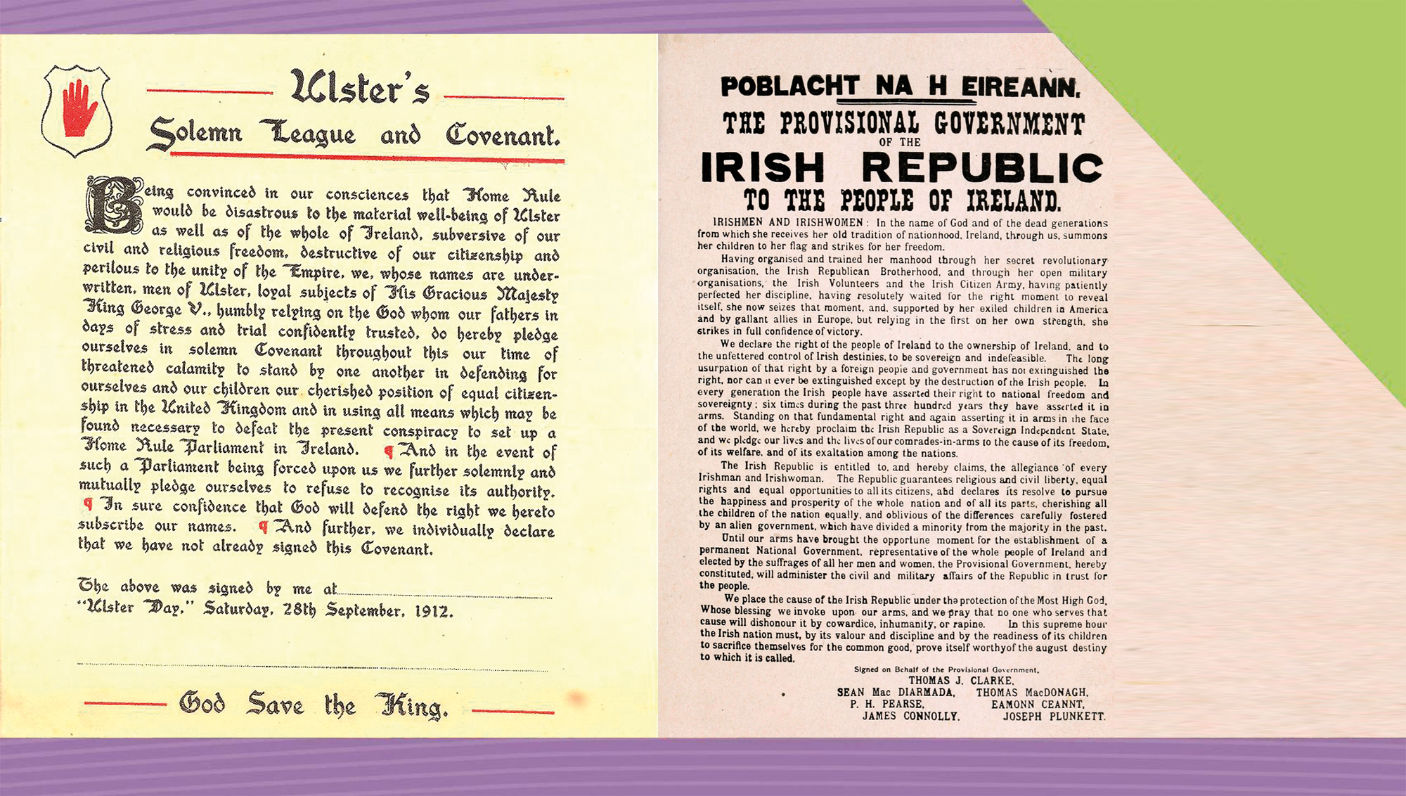
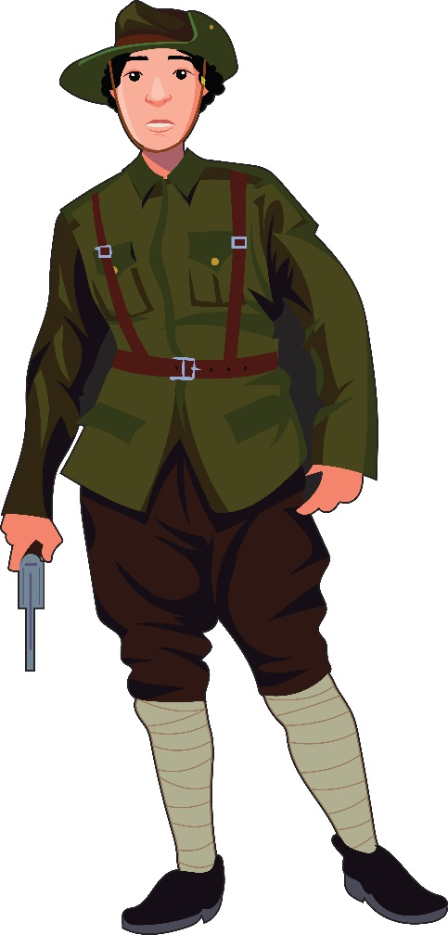

The Rise and Impact of Nationalism and Unionism in Ireland, 1911–23
15
Making History

Slide 2

What Will I Learn?
Examine the rise and impact of nationalism in Ireland
Examine the rise and impact of unionism in Ireland
Examine key events, 1911–23
Explore the Nature of History

Slide 3

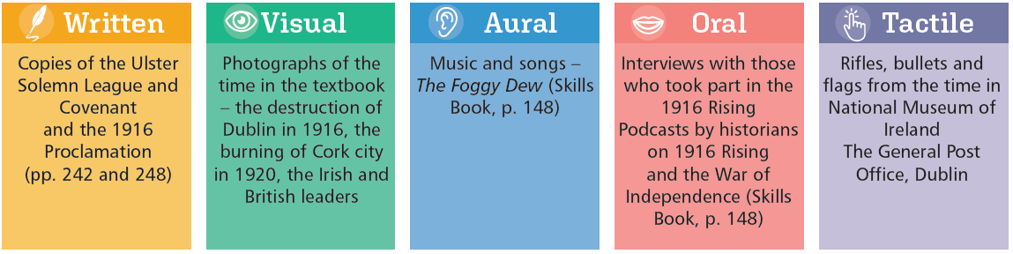
Sources for Nationalism and Unionism in Ireland

Slide 4
Key Words
Auxiliaries | ex-British Army officers who were enlisted in the Royal Irish Constabulary during the War of Independence
Black and Tans | ex-British Army soldiers who were enlisted in the Royal Irish Constabulary during the War of Independence
Blood sacrifice | Pearse’s idea that the death of martyrs was necessary to revive the spirit of the Irish nation
Bloody Sunday | day in which Collins’ Squad killed British spies and Auxiliaries killed spectators in Croke Park in revenge during the War of Independence
Flying column | small units of IRA that ambushed British forces during the War of Independence
Guerrilla warfare | military action carried out by small groups of irregular soldiers against usually larger regular forces
Home Rule | Irish nationalist policy that wanted self-government in Ireland with a parliament in Dublin dealing with internal Irish affairs
Partition | the division of Ireland between north and south with a border
Passive resistance | opposition to government policies by non-cooperation and nonviolent methods
Rising | an armed attempt at overthrowing a government; a rebellion, physical force tradition
Sectarianism | a form of hatred aimed at opposing (usually) religious groups
Squad | group of IRA volunteers formed by Michael Collins to kill British spies and others during the War of Independence
Unionist | a supporter in Ireland (and later Northern Ireland) of the union between Ireland (and later Northern Ireland) with Britain

Slide 5
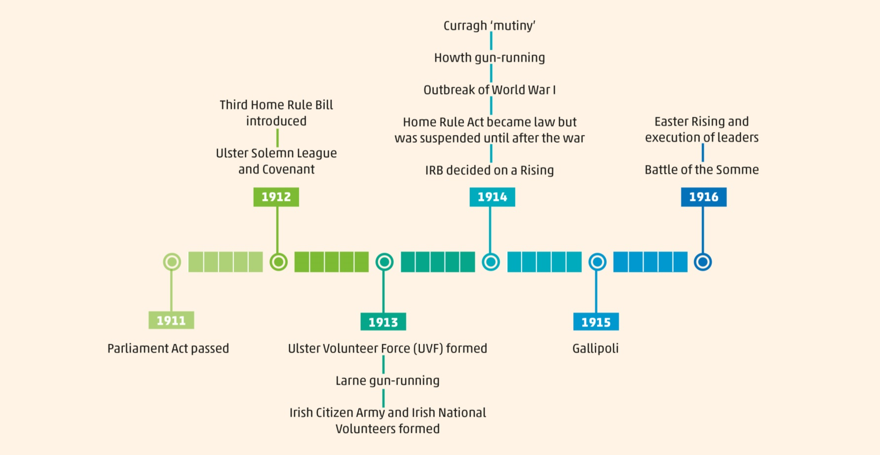
Timeline

Slide 6
What was Nationalism and Unionism?
Nationalists
… wanted changes in the way Ireland was ruled. They wanted some form of self-government with a parliament in Dublin.
Unionists
… wanted to keep the system as it was, with a parliament in Westminster making laws for Ireland.
Mostly Catholics
Mostly Protestants

Slide 7
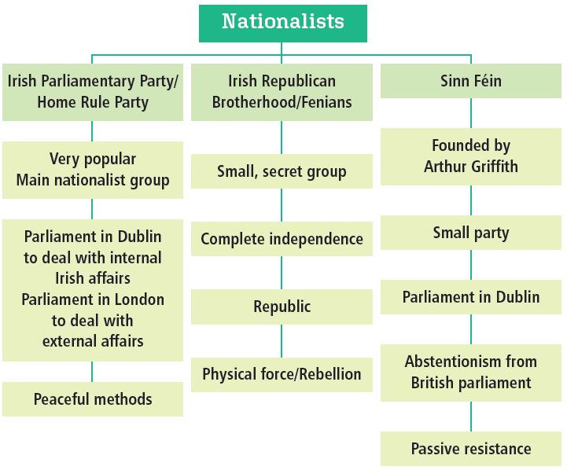
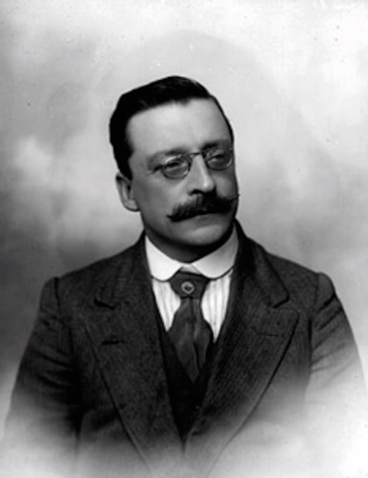
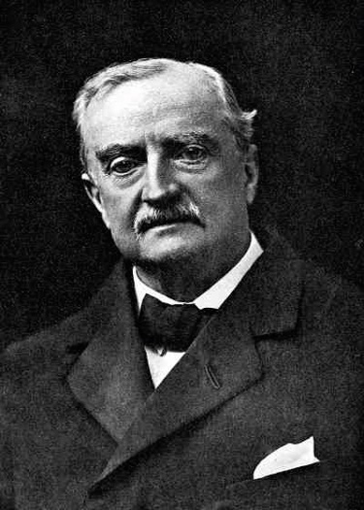
Different Nationalists
Arthur Griffith
John Redmond

Slide 8
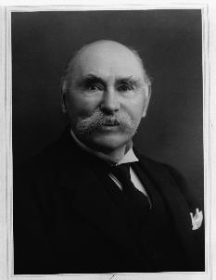
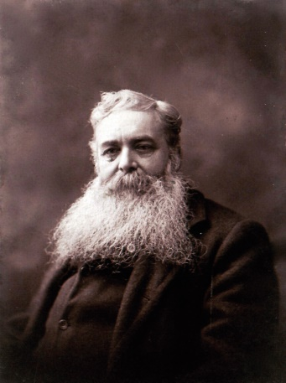
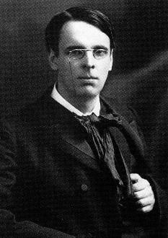
What was the Influence of Cultural Nationalism?
Worked for an Irish Ireland or Gaelic Ireland
Cultural Revival
Douglas Hyde
Michael Cusack
Gaelic Athletic Association (GAA)
Gaelic League
Anglo-Irish literary movement
W. B. Yeats

Slide 9
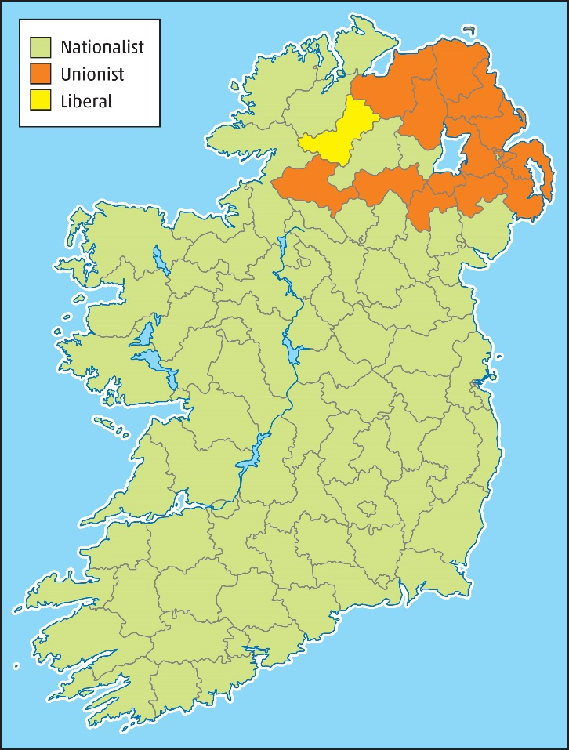
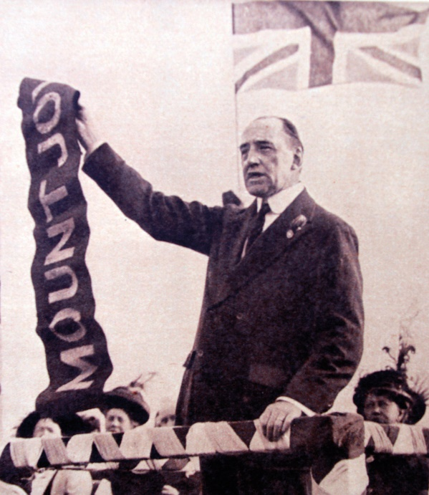

Unionists
1910 General election results
Majority lived in north-east of Ireland
Leaders – Edward Carson and James Craig
Unionism
Mostly in north-east of Ireland
Retain the Act of Union – Laws for Ireland made in parliament in Westminster
Edward Carson
Why were Unionist MPs mainly elected in the north-east of Ireland?

Slide 10

Assessing Your Learning
Match the Key Words and definitions:
1. Unionism | A. Complete independence from Britain
2. Home Rule | B. Promoted idea of an Irish Ireland or Gaelic Ireland
3. Nationalism | C. Self-government in Ireland with control of internal affairs
4. Republicanism | D. All people divided into nations and nations should have self-government
5. Cultural nationalism | E. Maintain union with Britain

Slide 11
Assessing Your Learning
Complete these sentences by choosing the correct endings.
Nationalists wanted … (i) changes in the way Ireland was ruled (ii) to keep the system as it was (iii) some form of self-government with a parliament in Dublin.
There were three main nationalist groups in Ireland in the early 20th century. These were …
(i) the Irish Parliamentary Party
(ii) the Irish Republican Brotherhood
(iii) the Irish Revolutionary Council
(iv) Sinn Féin.
The main body of unionists lived in …
(i) south-east of Ireland (ii) east of Ireland (iii) north-east of Ireland.
Groups involved in the cultural revival were … (i) the GAA (ii) the Gaelic League (iii) the Anglo-Irish Literary Revival (iv) the Gaelic Society.

Slide 12

The Home Rule Crisis, 1911–14
Conservative Party favoured unionism
Liberal Party favoured Home Rule for Ireland
After 1910 general elections, Liberal Party needed the support of Home Rule Party
Parliament Act 1911 – House of Lords could only delay laws for two years
Third Home Rule Bill, 1912
A parliament in Dublin would deal with internal Irish affairs
The parliament in Westminster would deal with external affairs
Home Rule could become law in 1914

Slide 13
The Home Rule Crisis, 1912–14
1913
Ulster Volunteer Force (UVF) formed
Larne gun-running
Irish Citizen Army and Irish National Volunteers formed
1911
Parliament Act passed
1912
Third Home Rule Bill introduced
Ulster Solemn League and Covenant
1914
Curragh ‘mutiny’
Howth gun-running
Outbreak of World War I
Home Rule Act became law but suspended until after the war
IRB decided on a Rising

Slide 14
Unionist Opposition
Ulster Solemn League and Covenant signed by over 200,000 men on 28 September 1912
Similar declaration signed by a quarter of a million women
Huge demonstrations, e.g. 50,000 people
Unionist Opposition to Home Rule
Ulster Volunteer Force (UVF) founded, January 1913 – 10,000 members
Imported arms and ammunition – Larne gun-running, April 1913 35,000 guns, 5 million rounds of ammunition
Support from Conservative Party

Slide 15
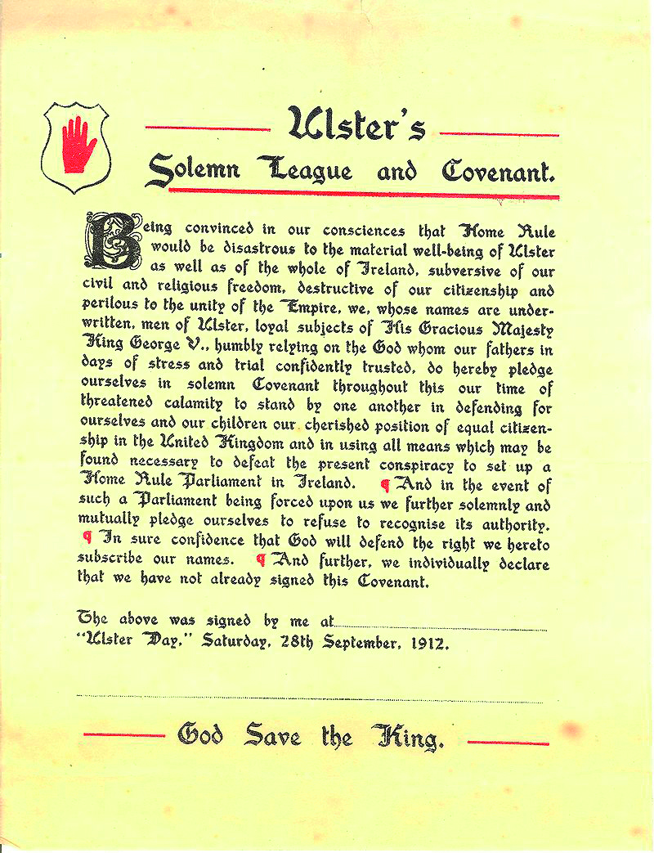
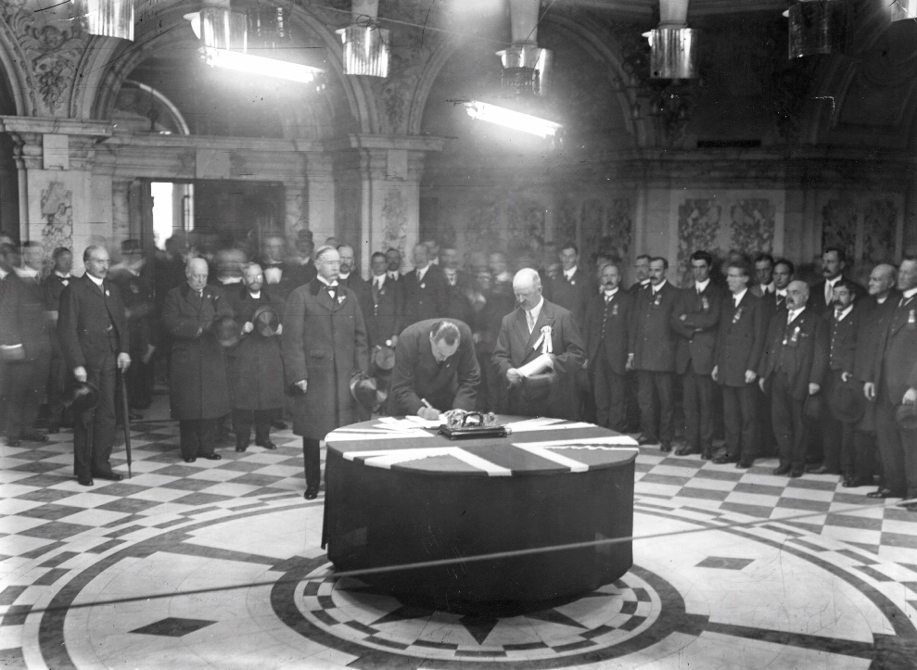
Unionist Opposition
Carson signing the Ulster Solemn League and Covenant in Belfast

Slide 16
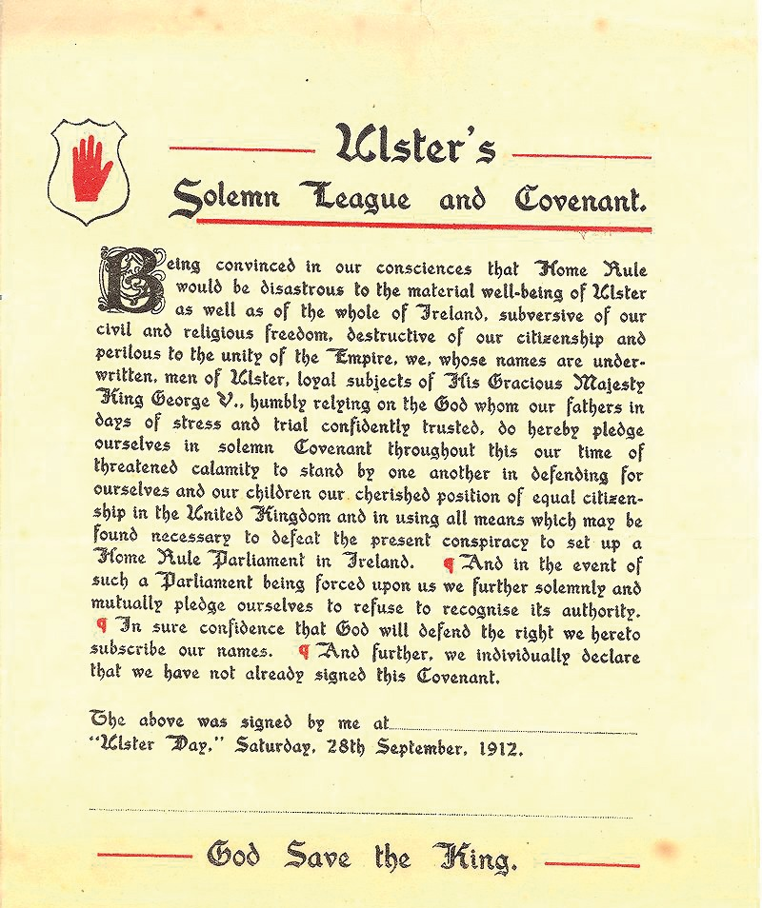
Unionist Opposition
What are the main points of the Ulster Solemn League and Covenant? p. 242

Slide 17
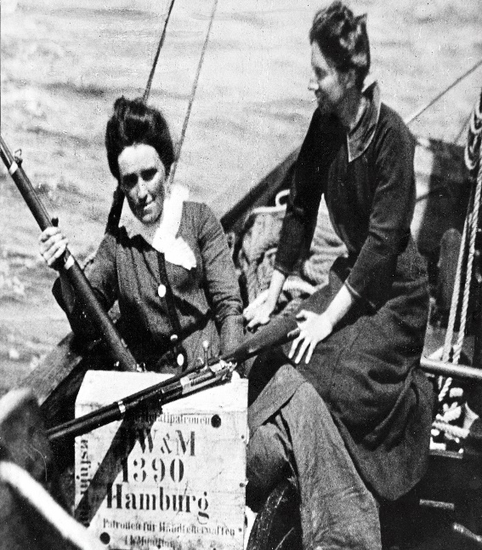
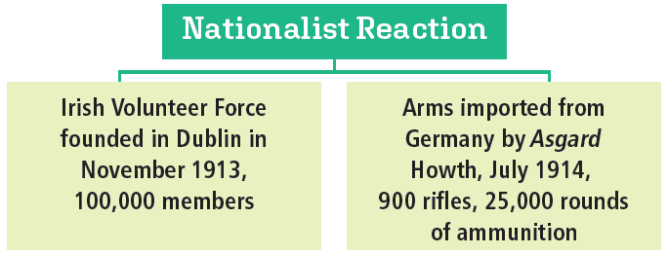
Nationalist Reaction
Eoin McNeill, Professor of History, UCD wrote ‘The North Began’
Nationalists should follow the example of Northern unionists
No compromise between nationalists and unionists on the Third Home Rule Bill
Ireland seemed to be heading for civil war
But World War I began
Home Rule was suspended

Slide 18
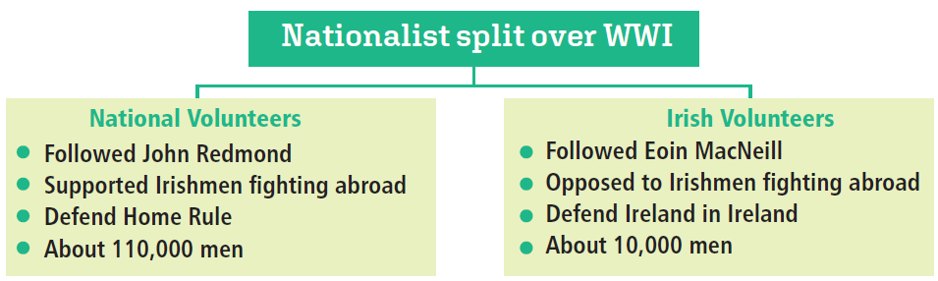
Nationalist Reaction to World War I

Slide 19
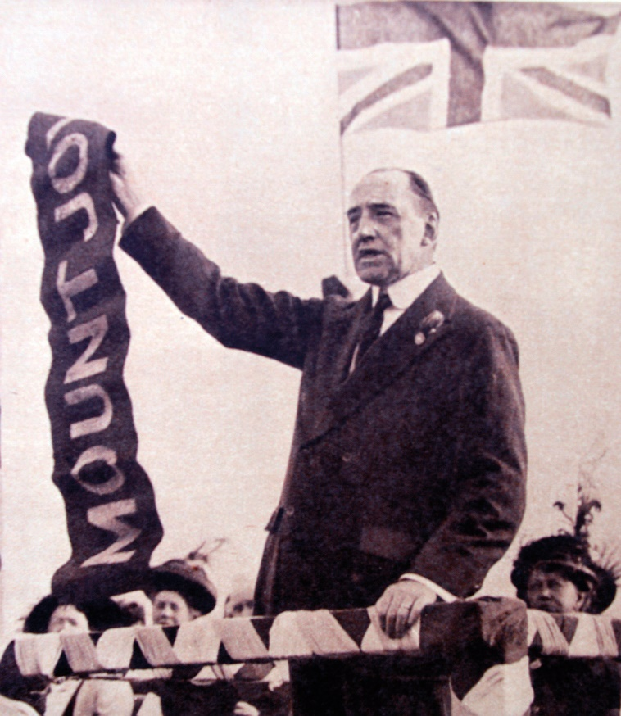
Unionist Reaction to World War I
Unionists in Northern Ireland
Carson asked the Ulster Volunteer Force ‘to answer immediately his Majesty’s call’ to arms
Ulster Volunteers enlisted in Ulster Division
Nationalists treated differently
Nationalist recruitment slowed down

Slide 20
Assessing Your Learning
Fill in the missing words from the box below:
John … was leader of the … … Party from 1900 to 1918. The introduction of the 1911 … Act meant that Home Rule would become law by … Unionists set up the … … Force to resist … … Unionists imported arms to … and they signed the Ulster … … and … The Unionists were led by … and … The Irish Volunteers smuggled arms into the country at …, Co. Dublin. British Army officers threatened to resign if they were ordered to enforce Home Rule in … This was called the … Mutiny. Civil War in Ireland was prevented by the outbreak of … … …
World War I Carson Parliament Home Rule
Redmond Craig Larne Solemn
Howth League Covenant Curragh
1914 Volunteer

Slide 21
Assessing Your Learning
Which British political party supported Home Rule for Ireland? (i) the Conservative Party or (ii) the Liberal Party
The Act that said the House of Lords could only delay laws for two years was called (i) the House of Lords Act, 1911 or (ii) the Parliament Act, 1911?
In 1912, Prime Minister Asquith introduced (i) the Second Home Rule Bill or (ii) the Third Home Rule Bill?
All of the following about unionist opposition to Home Rule are true except (i) organised huge demonstrations (ii) imported arms to Belfast (iii) signed the Ulster Solemn League and Covenant.
Eoin MacNeill said the nationalists should form their own volunteer force in an article called (i) ‘A Cry to Arms’ (ii) ‘The North Began’ (iii) ‘We Need Irish Volunteers’.
Where did the Irish Volunteers import arms?
The Irish Volunteers spilt because of (i) differences over where to import arms (ii) differences over where Irishmen should defend Home Rule during World War I or (iii) differences over where they would set up their headquarters?

Slide 22

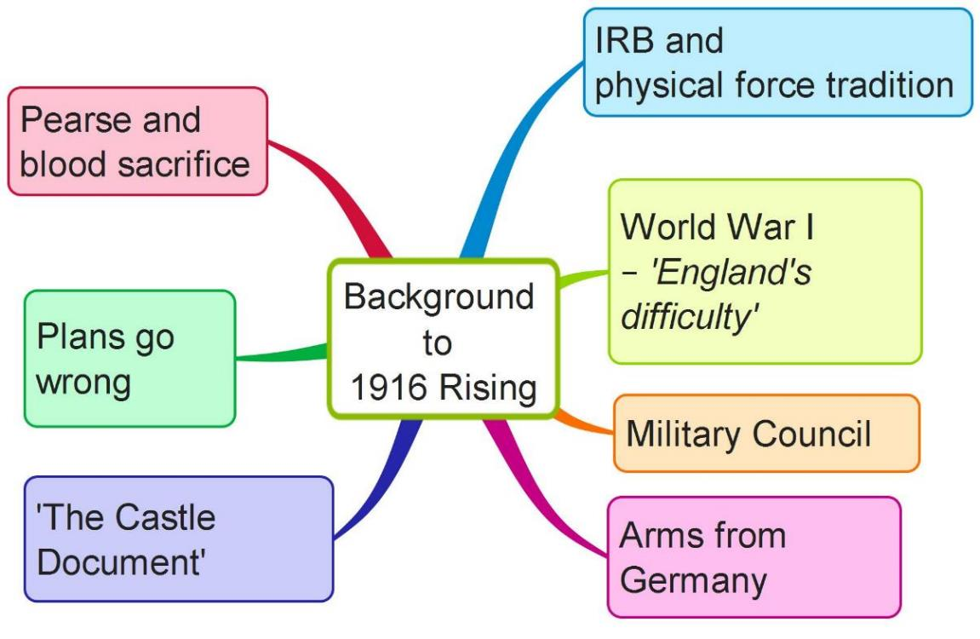
The 1916 Rising
Complete a mind map on the Background to the 1916 Rising using the above features

Slide 23
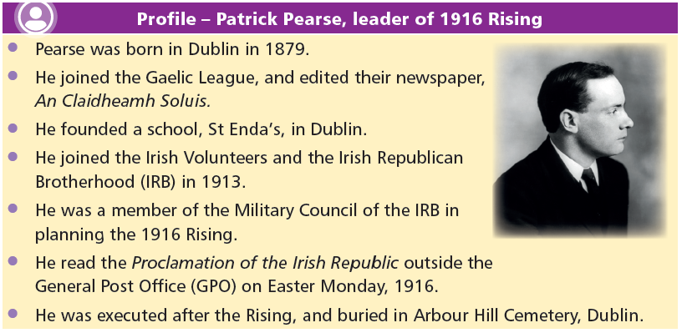
How significant a role did Patrick Pearse play in the 1916 Rising?

Slide 24

Pearse and the Use of Violence
… We must accustom ourselves to the thought of arms, to the sight of arms, to the use of arms. We may make mistakes in the beginning and shoot the wrong people; but bloodshed is a cleansing and a sanctifying thing, and a nation which regards it as the final horror has lost its manhood.
(Source: Patrick Pearse, The Coming Revolution [1913])
1. What is Pearse’s attitude to ‘bloodshed’?
2. Why is this called the ‘blood sacrifice’?

Slide 25
Assessing Your Learning
The 1916 Rising was organised by the Military Council of (i) the Irish Parliamentary Party (ii) Sinn Féin OR (iii) the Irish Republican Brotherhood?
The Military Council sent (i) John Redmond (ii) Roger Casement OR (iii) Arthur Griffith to Germany to get arms?
The leader of the Irish Volunteers, Eoin MacNeill, was (i) in favour of a rising immediately (ii) opposed to a rising OR (iii) only wanted a rising after World War I?
Which of the following statements about the plans for the Rising going wrong are true? (i) the Aud carrying arms from Germany was captured (ii) Eoin MacNeill found out that the Castle Document was a forgery (iii) the British Government arrested some of the leaders.

Slide 26
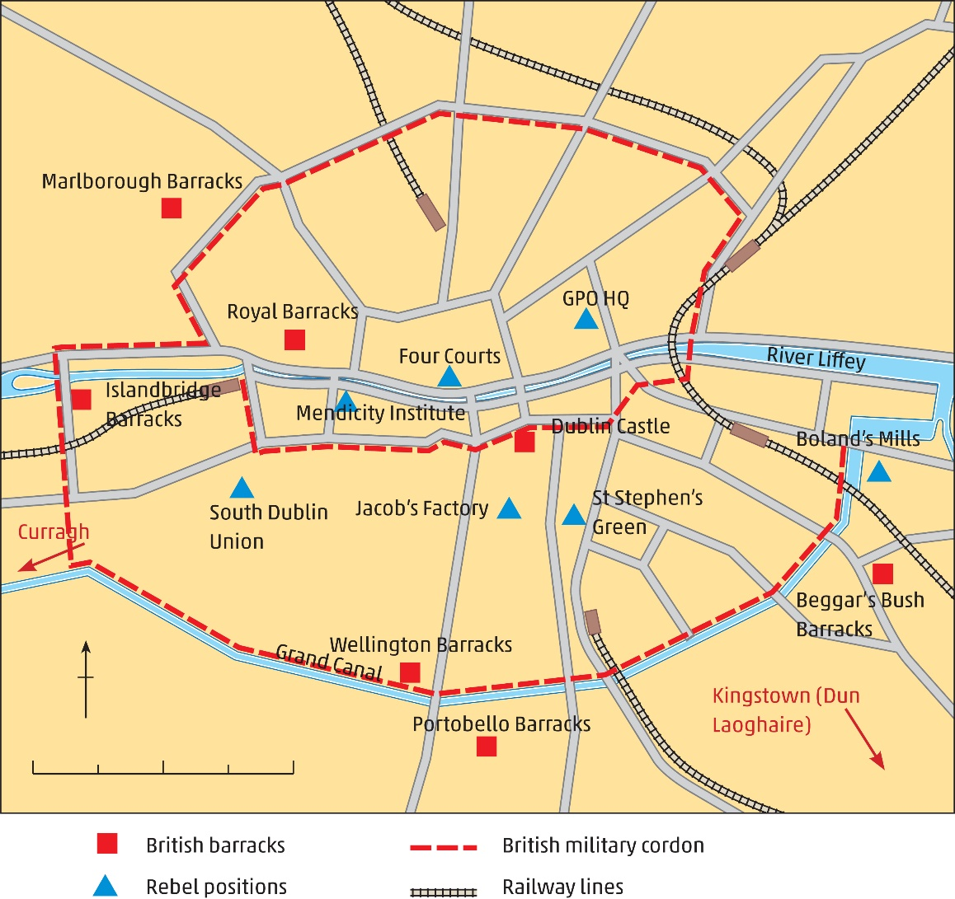
The Rising Goes Ahead
Easter Monday, 1916
1,500 Volunteers
Captured key buildings in Dublin
GPO became HQ
Pearse read the 1916 Proclamation

Slide 27
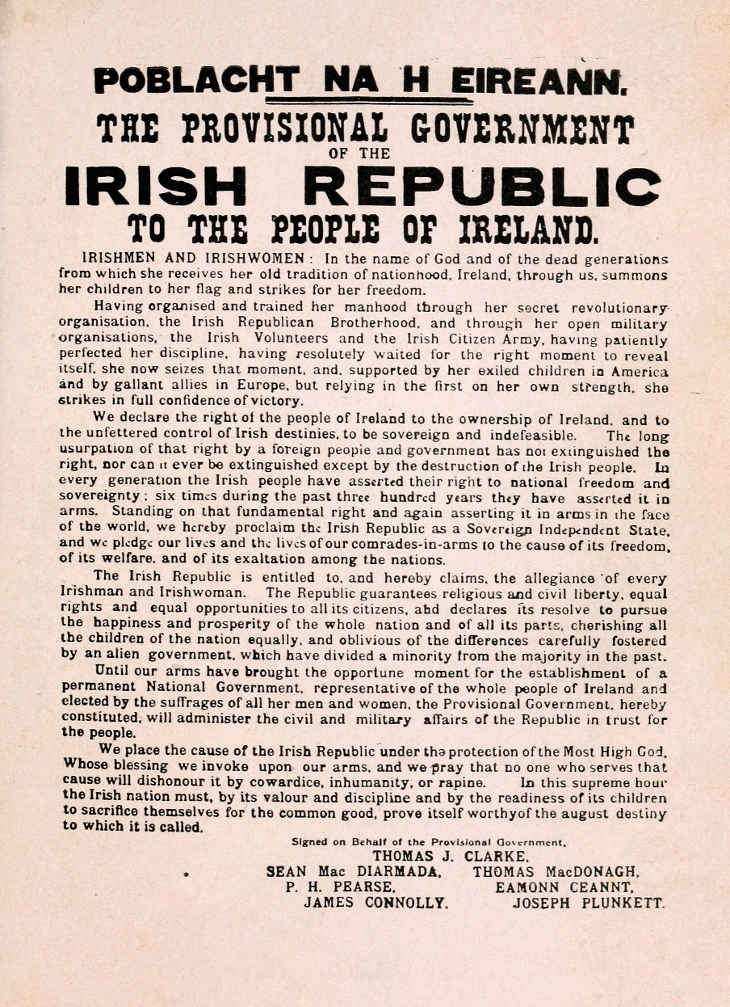
What are the main points of the 1916 Proclamation?

Slide 28
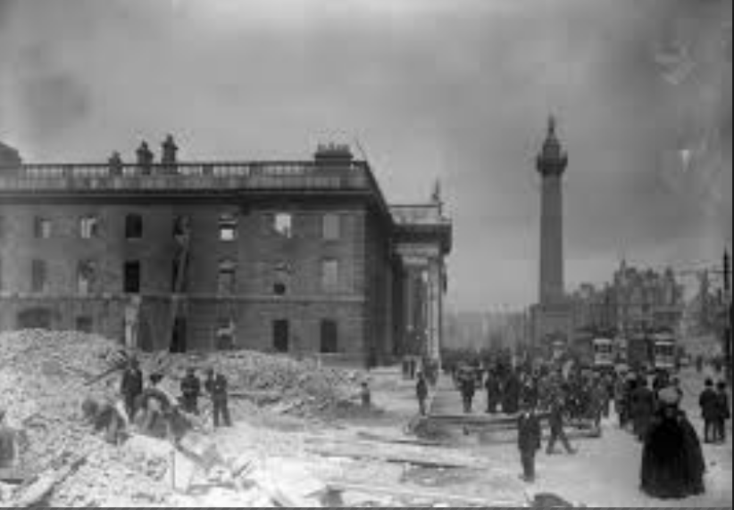
The British Government Reaction
Caught by surprise
Reinforcements from the Curragh and Britain
Military cordon around centre of Dublin
Artillery and gunboat, Helga, brought in
Rebels surrounded
Pearse surrendered unconditionally
Rebels rounded up
16 leaders executed
The GPO after the Rising

Slide 29
Assessing Your Learning
The Rising went ahead on Easter Monday, influenced by Pearse’s ideas of (i) a blood sacrifice (ii) the Solemn League and Covenant OR (iii) an industrial Ireland?
The headquarters of the Rising were in (i) Dublin Castle (ii) the GPO OR (iii) Trinity College?
The 1916 Proclamation was read by (i) MacNeill (ii) Connolly OR (iii) Pearse?
The British Army outnumbered the rebels by (i) ten to one (ii) 20 to one OR (iii) 25 to one?
The British Army used a gunboat called (i) the Avoca (ii) the Asgard OR (iii) the Helga?
The leaders of the 1916 Rising were executed in (i) Mountjoy Jail (ii) Kilmainham Jail OR (iii) Arbour Hill Prison?

Slide 30
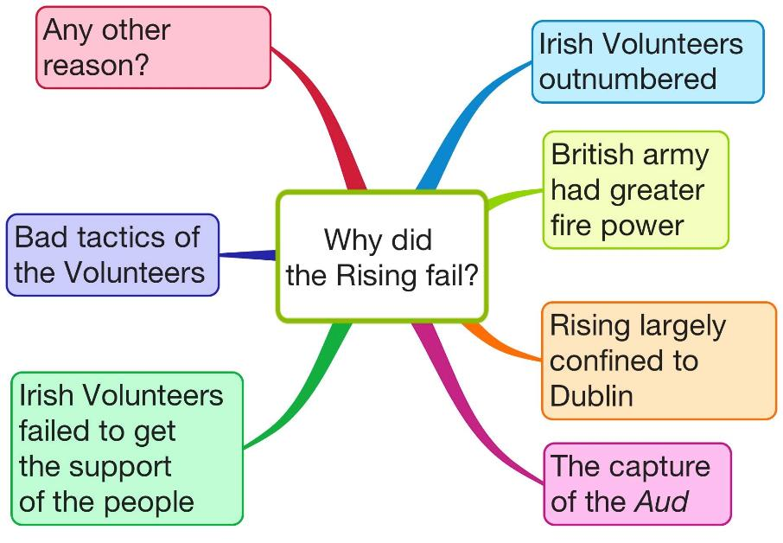
Why did the 1916 Rising Fail?
Was the Rising a military failure and a political success?
Create your own mind map on Why the Rising failed using the above features

Slide 31
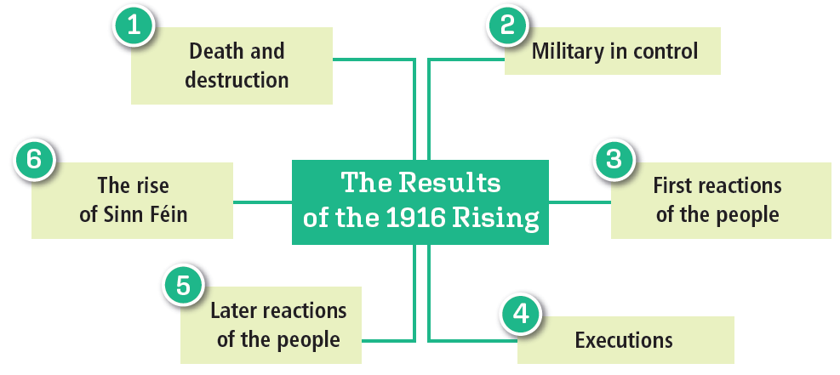
The Results of the 1916 Rising
Create your own mind map on the Results of the Rising using the above features

Slide 32

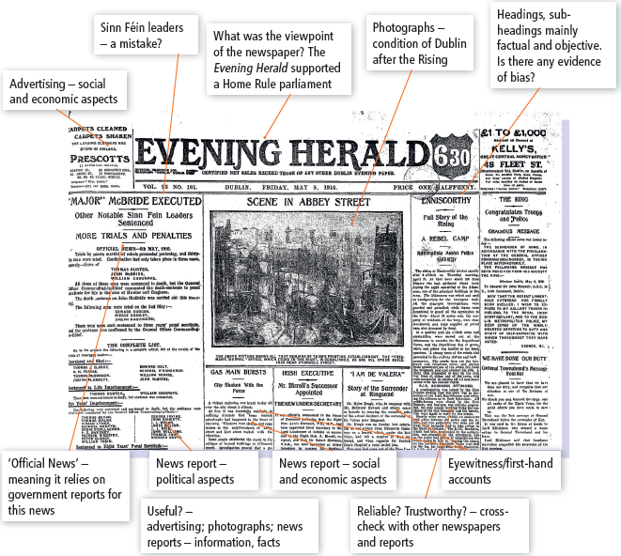
What can we learn about the usefulness and limitations of newspapers as sources for historians?

Slide 33
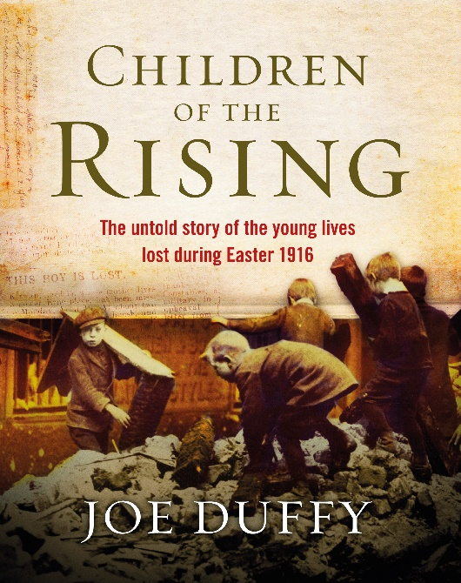
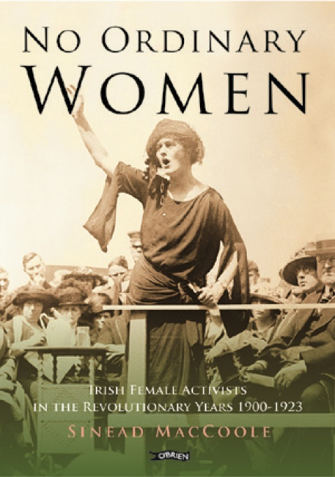
New Interpretations
New research
Joe Duffy, Children of the Rising (2015)
Deaths of 40 children
Aged two to 16
Rich and poor
Catholics and Protestants
Sinead McCoole, No Ordinary Women (2015)
Role of women in the Revolutionary Years
Spies, snipers, couriers, gun-runners, medics
Cumann na mBan
Irish Citizen Army

Slide 34
Assessing Your Learning
How did (i) unionists and (ii) nationalists react to the outbreak of World War I?
Who planned the 1916 Rising and why?
What problems were faced in planning the Rising?
How did the plans for the Rising go wrong?
What happened during the week of the Rising?
To what extent did the Rising fail?
Put the results of the Rising in order of importance or significance, beginning with what you consider is the most important result:
Results | Your order of significance
Deaths
Destruction
Military in control
People’s reaction
Executions
Rise of Sinn Féin

Slide 35
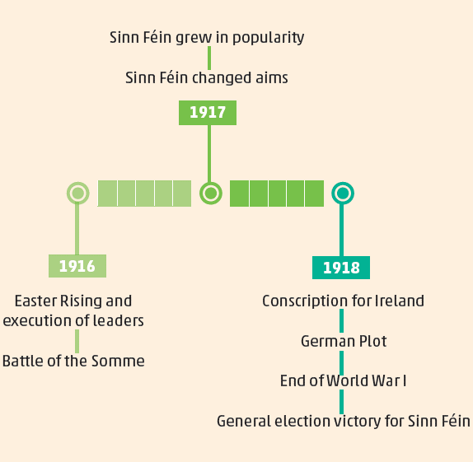
The Rise of Sinn Féin
Éamon de Valera became President of Sinn Féin and President of the Irish Volunteers
Sinn Féin won by-elections
Britain tried to introduce conscription in 1918
Sinn Féin led victorious anti-conscription campaign
Sinn Féin won 1918 general election
Favoured a republic and abstentionism
1910 AND 1918 GENERAL ELECTION RESULTS
 | 1910 | 1918
Home Rule Party | 73 | 6
Sinn Féin | 0 | 73
Unionists | 19 | 23

Slide 36
Assessing Your Learning
All of the following are reasons why the 1916 Rising failed except
(i) the Irish Volunteers were outnumbered
(ii) the British Army could use artillery or
(iii) the Rising was supported by most nationalists?
What serious political mistakes were made by the British Government in its handling of the 1916 Rising?
The number of people killed during the Rising was about (i) 389 (ii) 500 OR (iii) 750?
The first reaction of the people of Dublin to the Rising was (i) anger (ii) pride OR (iii) encouragement?
The number of leaders executed after the Rising was (i) 11 (ii) 15 OR (iii) 16?
People’s opinions about the Rising changed because (i) the British Government did not arrest more people (ii) of executions and arrests OR (iii) the British Army was winning World War I?
Which of the following are reasons why Sinn Féin rose in popularity (i) the anti-conscription campaign (ii) the British Army won World War I (iii) the German Plot?

Slide 37

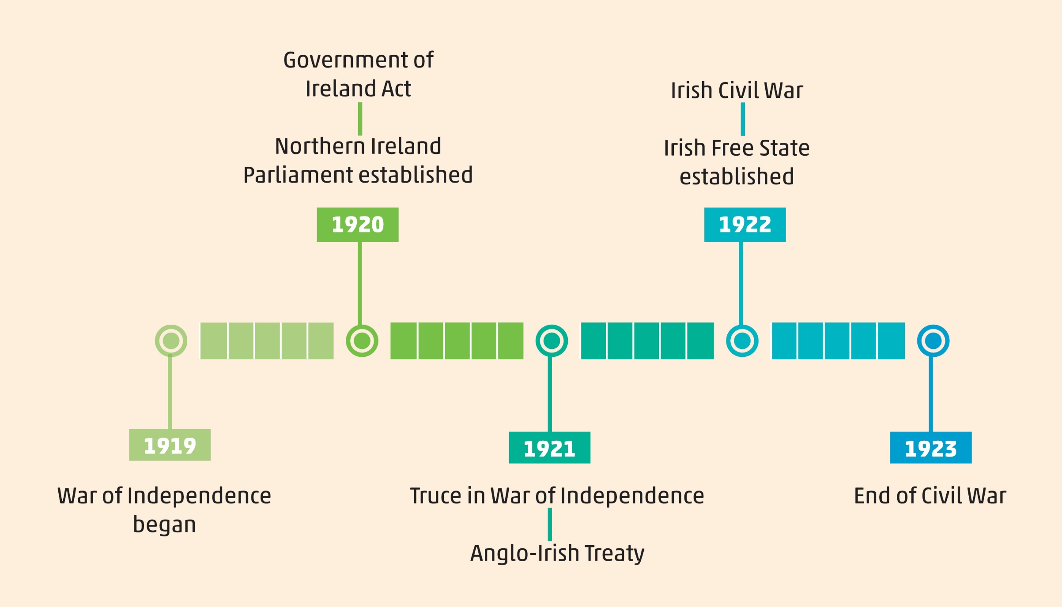
The Independence Struggle, 1919–21

Slide 38
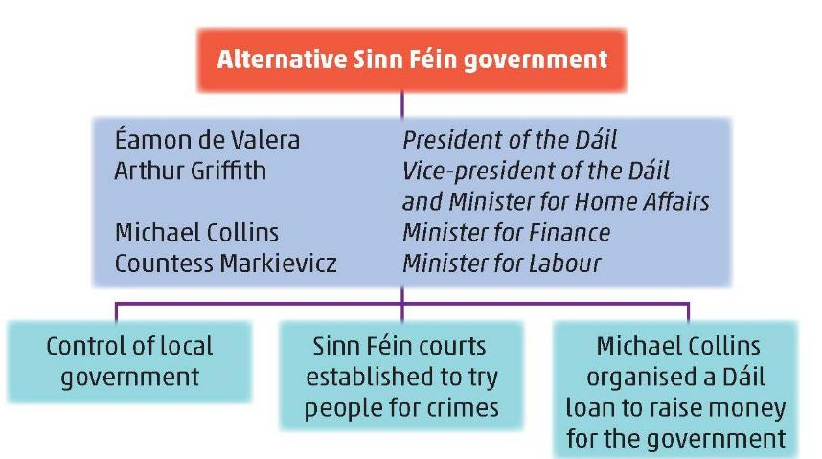
The Independence Struggle, 1919–21
Independence Struggle
Passive resistance
Guerrilla warfare
First Dáil

Slide 39
Assessing Your Learning
What is passive resistance?
Who was head of the alternative Sinn Féin Government?
What actions did the Sinn Féin Government carry out?
Why were these actions important?

Slide 40
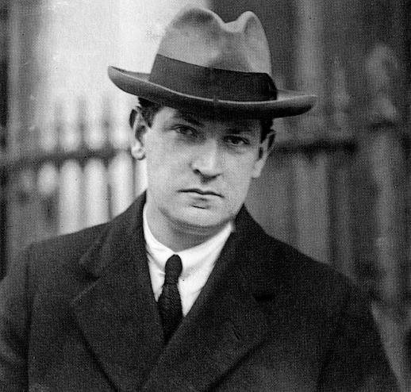
War of Independence, 1919–21
Military conflict
Role of Michael Collins
Operated intelligence network
Organised ‘The Squad’
Ambush of RIC at Soloheadbeg, Co. Tipperary 21 January 1919
First shots of War of Independence
Guerrilla warfare
‘Hit and run’
Attacks on RIC barracks
Raids for arms and ammunition
RIC intimidated
Flying Columns developed
Large-scale ambushes
Michael Collins

Slide 41
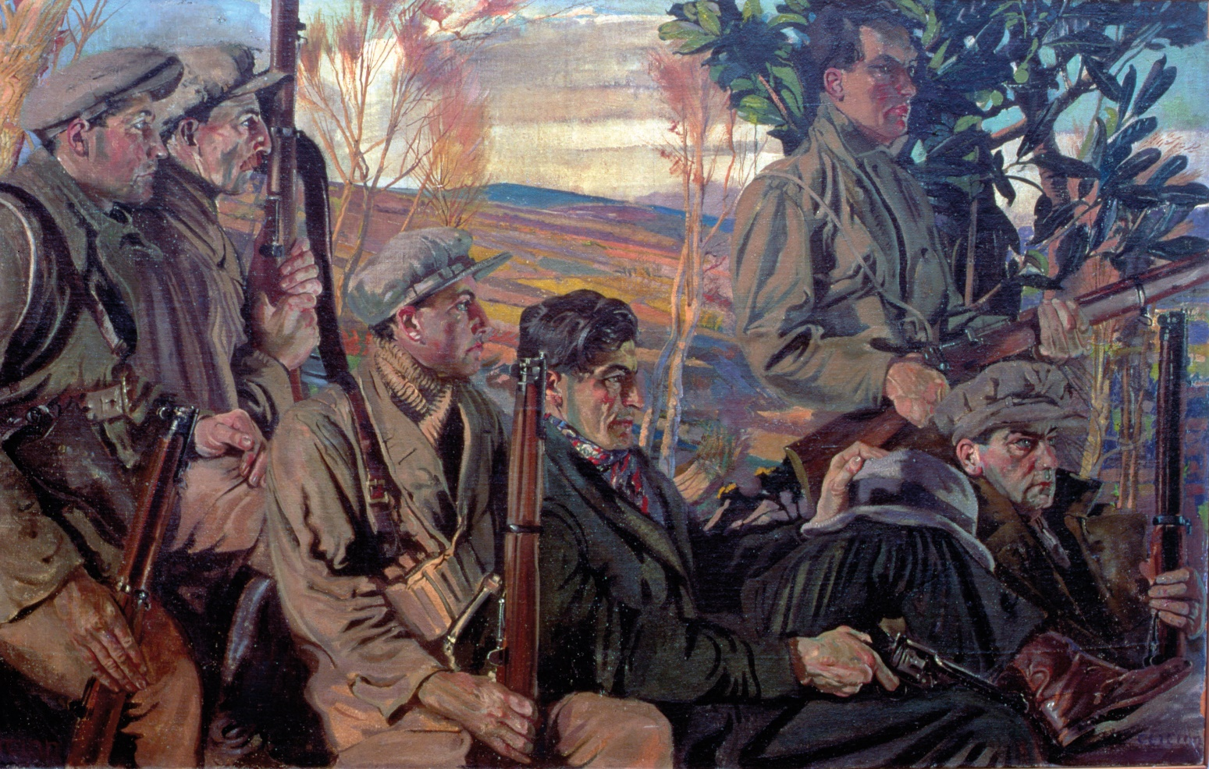
Source
Objective?
Reliable?
Useful?
Seán Keating’s (1889–1977) painting of a flying column from the North Cork Brigade IRA, Men of the South, painted in 1921 (Crawford Art Gallery, Cork)

Slide 42
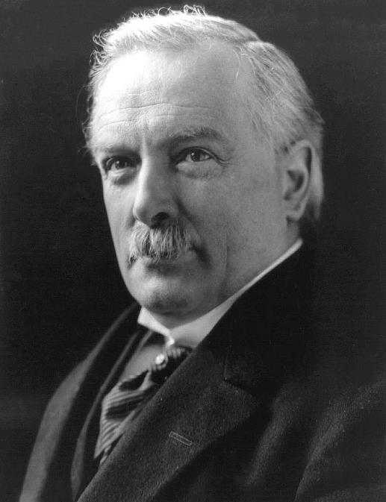
British Response
David Lloyd George, Prime Minister
Recruited ‘Black and Tans’ and Auxiliaries (‘Auxies’)
Use of reprisals
Introduced Government of Ireland Act 1920
Sinn Féin rejected the Act
Parliament set up in Belfast; partition established

Slide 43
Assessing Your Learning
What happened the same day as the First Dáil met?
What are guerrilla war tactics?
What were flying columns?
What part did Michael Collins play?
What was the Squad?
How did the British Government respond to the IRA tactics?

Slide 44
Major Incidents of the War of Independence
Put these events of the War of Independence in chronological order
Terence MacSwiney, Lord Mayor of Cork, died on hunger strike in Brixton Prison, London, after 74 days
Ambush at Kilmichael
Members of the RIC murdered Tomás MacCurtain, Lord Mayor of Cork, in front of his family
Ambush at Crossbarry
Bloody Sunday – Collins’ Squad killed 11 British agents sent specially to catch him. Black and Tans shot into Croke Park during a football match, killing 12 people
IRA attack on the Custom House, Dublin; over 80 IRA captured

Slide 45
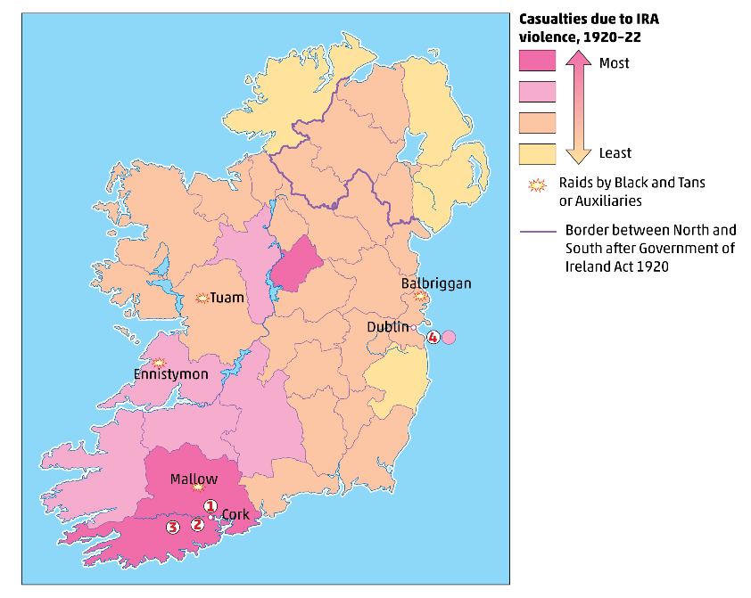
Major Incidents of the War of Independence
What counties experienced the most incidents in the War of Independence?
What happened at 1, 2, 3 and 4?

Slide 46
Peace
IRA running short of arms and ammunition
Criticised at home and in America
Sinn Féin
British
Government
The people wanted peace
The war was costing a great deal of money
De Valera agreed terms of ceasefire with Lloyd George
Ceasefire on 11 July 1921

Slide 47
Assessing Your Learning
Fill in the missing words from the box below:
The War of Independence began when the IRA attacked an … patrol at … Co. Tipperary. On the same day, … … met in Dublin to issue a Declaration of … This was the beginning of a policy of … resistance. The IRA raided … for arms and … The IRA used … warfare. They organised themselves into … … which conducted …-… ambushes. They intimidated members of the … The British Government recruited ex-soldiers known as … and …, and ex-officers known as … Michael Collins, Director of …, set up the … of 12 assassins to kill British spies. The worst day of the War of Independence was … Sunday. There were ambushes in … and … in Co. Cork. The Government of … Act was passed in 1920 but the fighting continued until the truce in … 1921.
July Auxiliaries barracks RIC guerrilla
Soloheadbeg Dáil Éireann Crossbarry passive Intelligence
Kilmichael Squad Bloody Tans ammunition
large-scale Independence Black flying columns

Slide 48
Assessing Your Learning
What happened to two Lord Mayors of Cork?
What happened on Bloody Sunday, 1920?
Who organised the Kilmichael and Crossbarry Ambushes?
Why was Cork city burned?
What was the result of the attack on the Customs House?
Why did both sides want peace in 1921?

Slide 49

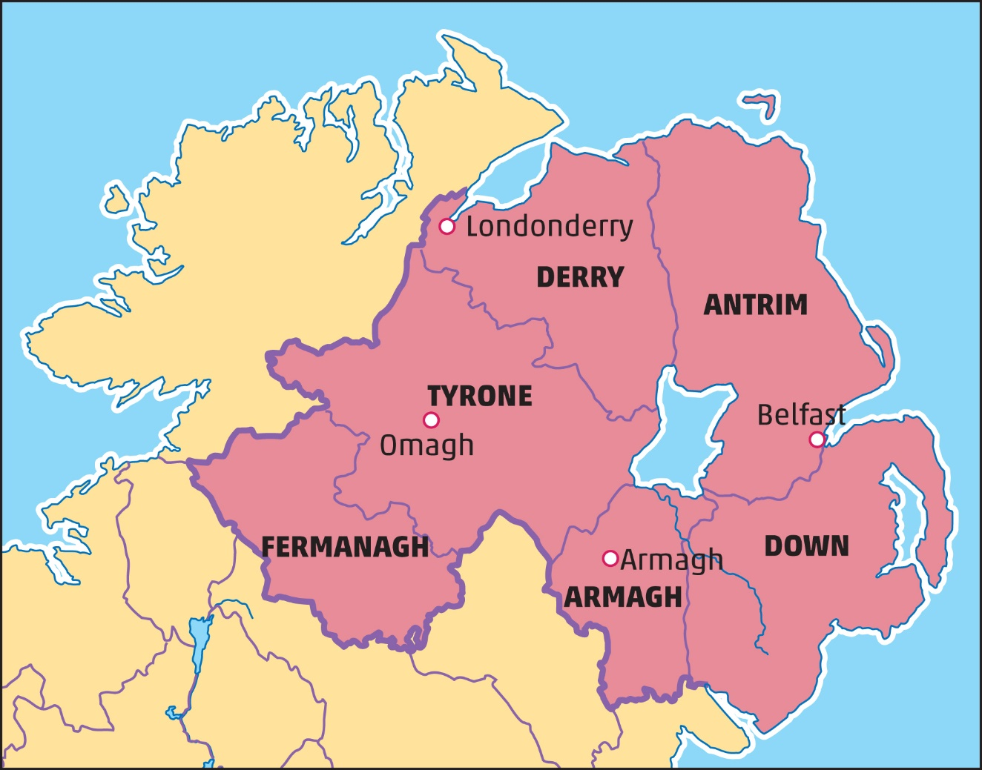
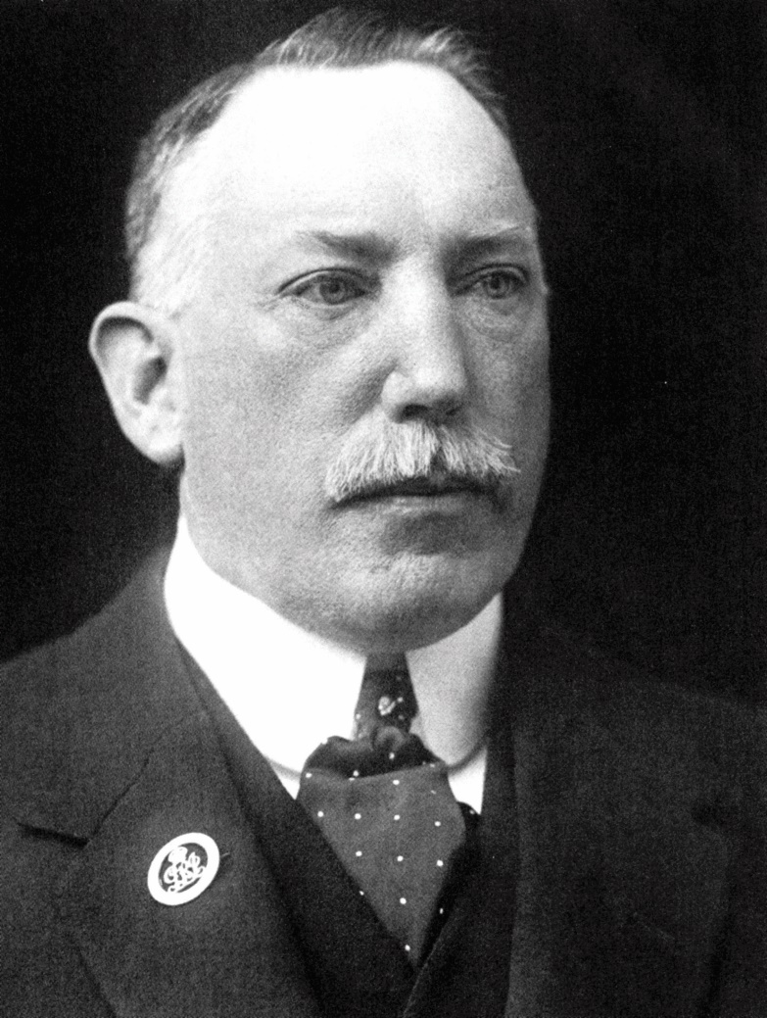
The Foundation of Northern Ireland
Government of Ireland Act 1920
Divided (partitioned) the country
Parliament in Northern Ireland
Control over internal affairs of Northern Ireland
Dominated by Unionist Party
The six counties of Northern Ireland
James Craig

Slide 50
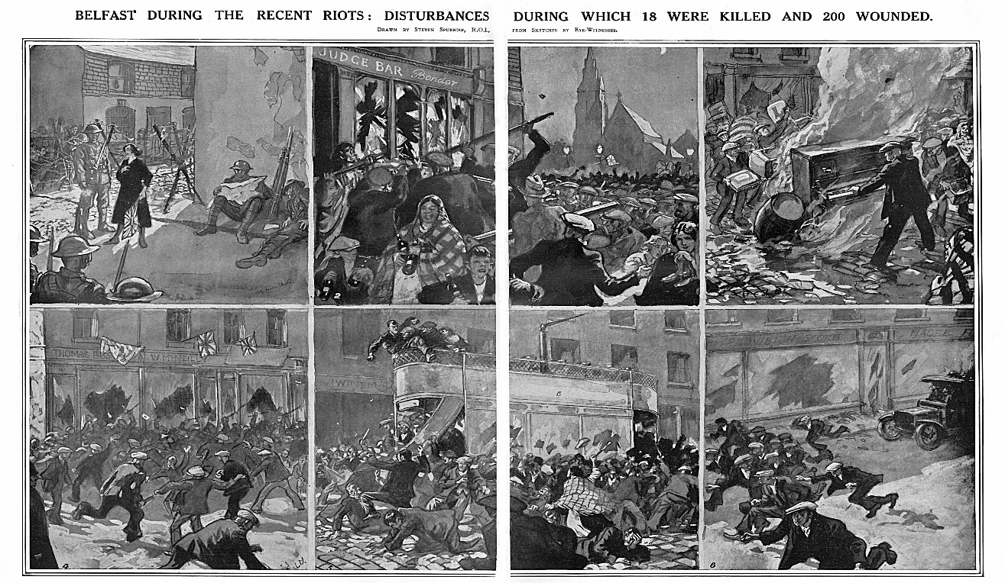
Conflict between Unionists and Nationalists
Unionists opposed to united Ireland
Feared Catholics wanted to destroy Northern Ireland
Royal Ulster Constabulary (RUC) and B-Specials
Special Powers Act
Sectarian riots
More Catholics killed than Protestants
Catholics lost jobs, e.g. Harland and Wolff
IRA campaigned in North until start of Civil War

Slide 51
Assessing Your Learning
How did attitudes to World War I differ between Northern nationalists and unionists?
How did (i) southern unionists and (ii) northern unionists react to the Government of Ireland Act, 1920?
Explain (i) RUC (ii) B-Specials (iii) Special Powers Act?
What are sectarian riots?
What happened in Harland and Wolff?
What happened to end the violence in Northern Ireland in 1922?

Slide 52

The Anglo-Irish Treaty, 1921
Delegations
Irish delegation
Griffith
Collins
Barton
Duggan
Gavan Duffy
British delegation
Lloyd George
Churchill
Chamberlain
Birkenhead
Why wasn’t de Valera on the Irish delegation?
Aims
Irish delegation
To achieve a republic
To prevent a border, or partition between North and South
British delegation
To keep Ireland within the British Commonwealth

Slide 53
The Terms of the Anglo-Irish Treaty, 1921
1. Ireland would be known as the Irish Free State.
2. Ireland would still be a dominion (part of) the British Commonwealth.
3. The King of England would be represented in Ireland by a Governor-general.
4. Members of the Dáil and Seanad (Senate) would take an oath of allegiance to the Irish Government and the King of England.
5. Britain would have the use of three ports (the ‘Treaty ports’) – Berehaven, Cobh and Lough Swilly.
6. A Boundary Commission would be established to decide on the border between the north and south of Ireland.
Signed by delegations on 6 December 1921

Slide 54
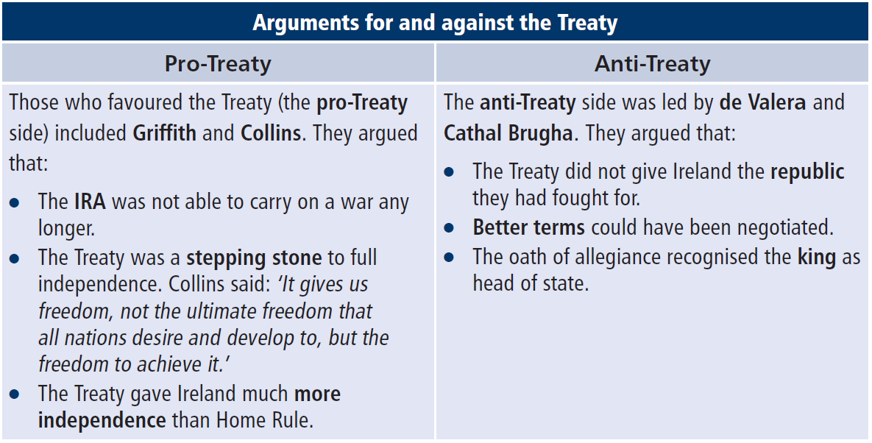
Treaty Debates and Result
Treaty Debates – December, 1921–January, 1922
The Result
For 64 | Against 57

Slide 55
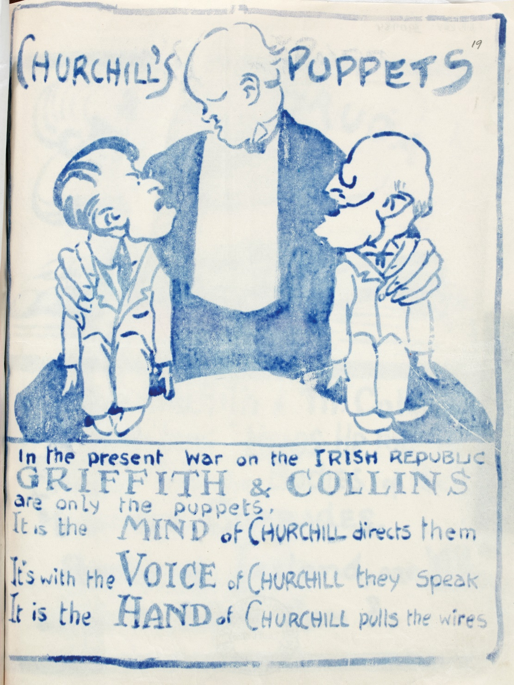
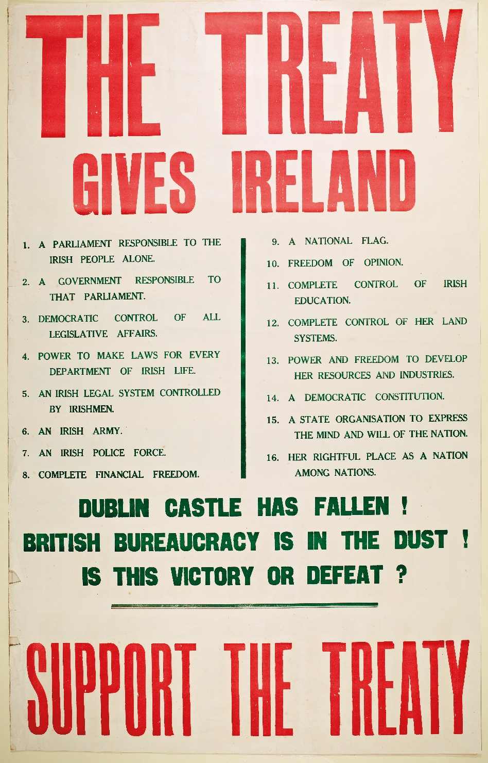
An anti-Treaty print attributed to Countess Markievicz
A pro-Treaty poster

Slide 56
Assessing Your Learning
Which were pro-Treaty arguments and which were anti-Treaty arguments?
Arguments | Pro-Treaty | Anti-Treaty
The oath of allegiance recognised the king as head of state.
The IRA was not able to carry on a war any longer.
The Treaty was a stepping stone to full independence.
The Treaty gave Ireland much more independence than Home Rule.
Better terms could have been negotiated.
The Treaty did not give Ireland the republic they had fought for.

Slide 57
Assessing Your Learning
Name two members of the Sinn Féin delegation who went to London to negotiate the Anglo-Irish Treaty.
Why did de Valera decide not to go on the delegation?
How did the Sinn Féin aims for the negotiations differ from the British aims?
Outline three key terms of the Anglo-Irish Treaty.
Explain one difference between the pro-Treaty view on the Anglo-Irish Treaty and an anti-Treaty view.

Slide 58
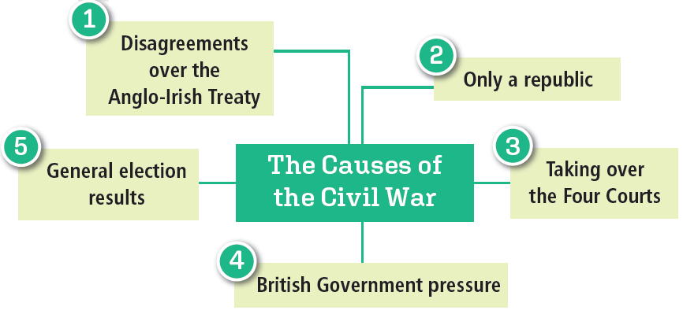
The Irish Civil War
General election results June 1922
Sinn Féin – pro-Treaty | 58
Sinn Féin – anti-Treaty | 36
The rest (including the Labour Party) – pro-Treaty | 34
Total – pro-Treaty | 92
Total – anti-Treaty | 36

Slide 59
The Irish Civil War – Who was Fighting?
Pro-Treaty | Anti-Treaty
Regulars | Irregulars
Free State government | Republicans
Government forces

Slide 60
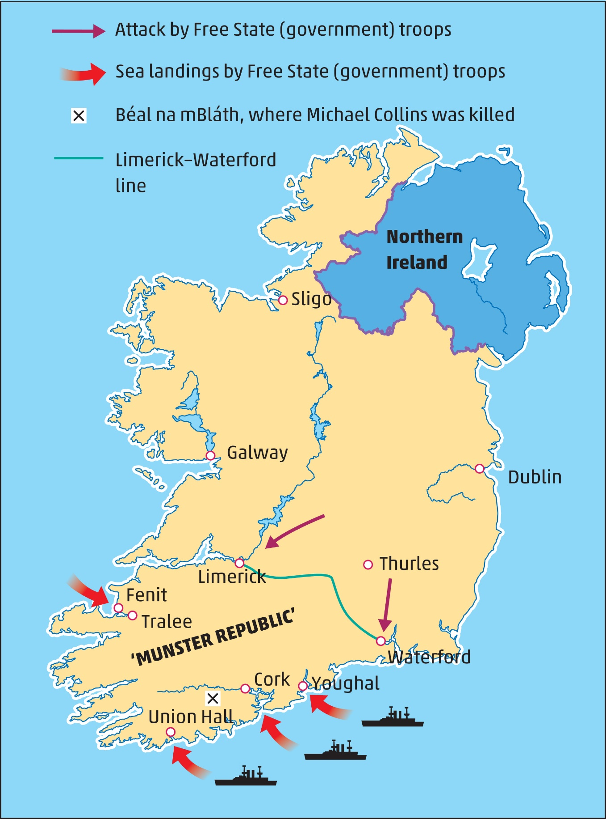
The Fighting Begins
Fighting in Dublin
Government attack on Four Courts
Victory in Dublin
The Munster Republic
Republicans retreat behind line from Limerick to Waterford
Both cities captured by government forces
Ships used to land troops in southern ports
Republicans retreat to the countryside
Death of Griffith and Collins
Griffith by brain haemorrhage
Collins in ambush at Béal na Bláth
Cosgrave and O’Higgins took over Free State government

Slide 61
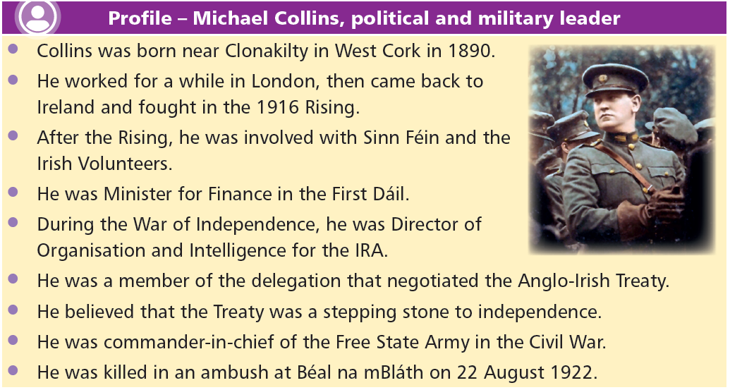

Slide 62
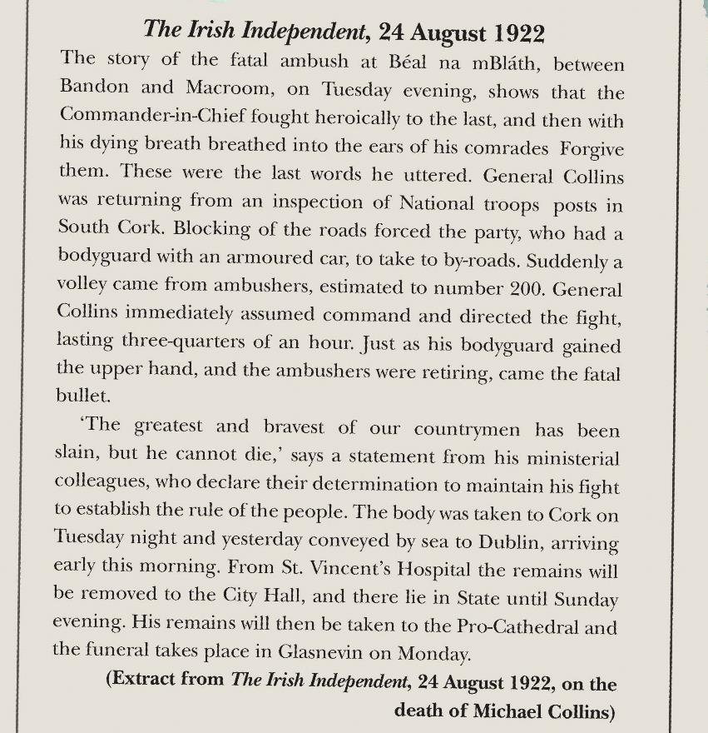
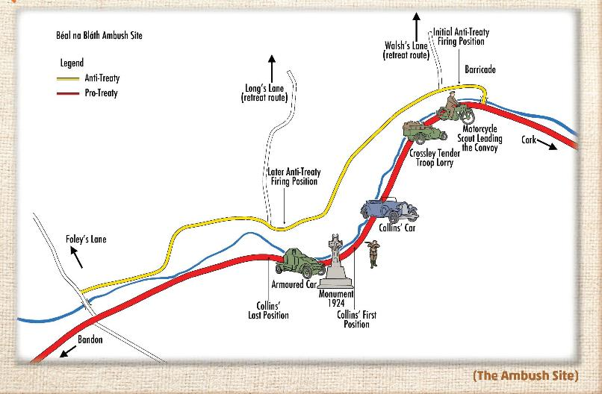
Ambush at Béal na Bláth

Slide 63
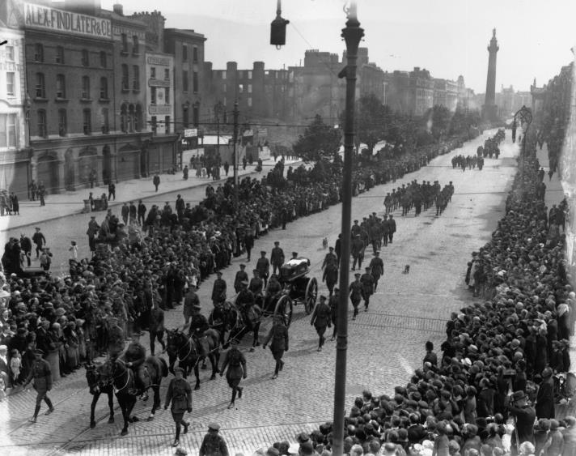
What are the strengths and weaknesses of photographs as sources for historians?
Funeral of Michael Collins

Slide 64

Guerrilla Warfare and the End of the Civil War
Republicans now used guerrilla warfare
Not as successful as in War of Independence
Why?
Most people supported the Treaty
Free State troops knew countryside just as well as Republicans
Why did the Regulars/government forces win the Civil War?
The Civil War ended in May, 1923.

Slide 65
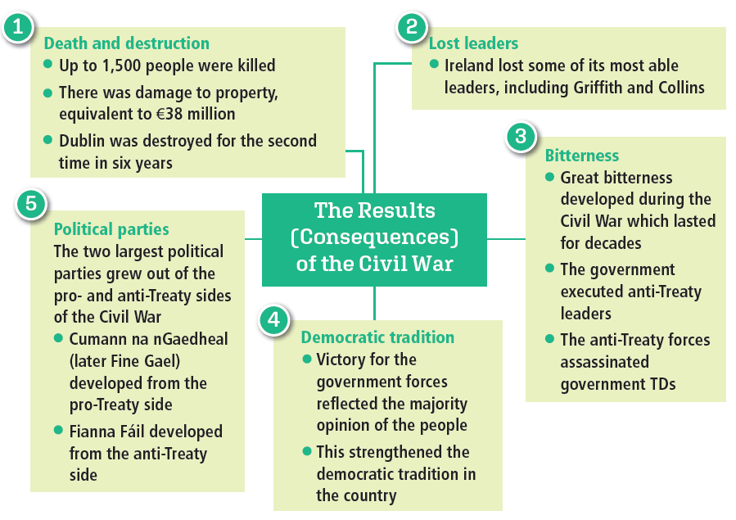
The Consequences of the Irish Civil War

Slide 66
Assessing Your Learning
Fill in the missing words from the box below:
The Civil War was caused by divisions over the …-… Treaty. The two sides were known as the … and the … The Anti-Treaty forces captured a … … general. The Government forces began the shelling of the … … in … The Anti-Treaty forces retreated behind a line from … to … This was known as the ‘… …’ One of the leaders of the government, …, died from a brain haemorrhage. Soon after Michael Collins was killed in an … in … na … in county … The new leaders of the Free State government were … and … The Civil War resulted in the destruction of Dublin for the … in … years. The Civil War resulted in the deaths of about … people. The Civil War created great …, and the country lost some of its ablest …
leaders Dublin Munster bitterness
ambush Griffith Waterford Free State
Regulars Cosgrave second Four Courts
Béal Irregulars 6 O’Higgins
Limerick Bláth Cork 1,500
Republic Anglo-Irish

Slide 67
Assessing Your Learning
Select two causes of the Irish Civil War and explain how they contributed to causing the war.
What was the first action of the Civil War?
What was the Munster Republic?
How did Griffith and Collins die?
Why wasn’t guerrilla warfare successful in the Civil War compared to the War of Independence?
How did the Civil War end?
Select two results (consequences) of the Civil War and explain their effects.

Slide 68

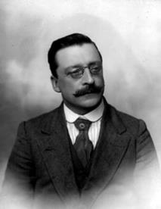







Assessing Your Learning
Identify the following leaders:
4
5
2
3
1
7
8
9
6

Slide 69

Historical Debate

Slide 70



Visit …
Glasnevin Cemetery and Museum to learn more about the key historical figures who are buried here.
The Garden of Remembrance, Parnell Square, Dublin
Kilmainham Gaol, Dublin
Independence Museum, Kilmurry, Co. Cork.

Slide 71

**Note your choices**

